Slide 1
Capstone Project
Airbnb Bookings Analysis
Submitted By : Kapil Kukreja

Slide 2
Project Summary
Airbnb is an American San Francisco-based company operating an online marketplace for short-term home stays and experiences. Guests and hosts have used Airbnb to expand on travelling possibilities and present a more unique, personalized way of experiencing the world. Today, Airbnb became one of a kind service that is used and recognized by the whole world. Data analysis on millions of listings provided through Airbnb is a crucial factor for the company. These millions of listings generate a lot of data - data that can be analyzed and used for security, business decisions, understanding of customers' and providers' (hosts) behavior and performance on the platform, guiding marketing initiatives, implementation of innovative additional services and much more.
In this project I do analysis on 2019 website data regarding listing on website, user reviews, compare prices, analysis host data. I analysis data and provide different visualization charts, different business insights using python language. I use Numpy library for creating data array that helps to analysis such big data. We also use panda library which offers data structures and operations for manipulating numerical tables and time series.

Slide 3
Points to Discuss
Data summery
Problem Statement
Making data analysis ready
Top 10 hosts according to their listing count
Finding ratio of each Room Type
Active host count per location
Average price of listing according to the location and Room Type
Highest and lowest rent according to location
Conclusion

Slide 4
Data Summery
We have total 16 variables/columns and 48896 rows or listings in our data.
Unique id: This contains unique numerical id of listing.
Name of listing: This contains name of Home/Apartment.
Unique host id: This contains unique numerical id of host who is listing their home.
Name of host: This contains name of host.
Neighborhood location: This contains location of Room in new york city.
Neighborhood area: This contains near by famous location of Room.
Latitude: This contains geographical locations of Room on map.

Slide 5
Longitude: This contains geographical locations of Room on map.
Type of room: This contains type of room for example Entire home, Private room or shared room.
Price of listing: This contains price of room in dollars.
Minimum nights: This contains minimum days for which booking is accepted.
Number of reviews: This contains count of reviews per Home/ Apartment.
Date of last review: This contains date of last review of Home/ Apartment.
Number of reviews: This contains count of customers reviews/checks per month.
Host listing count: This contains maximum listing count by a host.
Availability of rooms in 365 days: This contains maximum availability of room in days among one year.

Slide 6
Problem Statement
Data analysis on thousands of listings provided through Airbnb is a crucial factor for the company where data can have null or missing values.
In data price of some listing is zero which is not possible by removing or revising rates of those listing data became analysis ready.
Our main objective is to find out the key metrics that influence the listing of properties on the platform. For this, we will explore and visualize the dataset of Airbnb in New York city using basic exploratory data analysis (EDA) techniques.
We will be finding out the distribution of every Airbnb listing based on their location, including their price range, room type, availability, and other related factors.

Slide 7
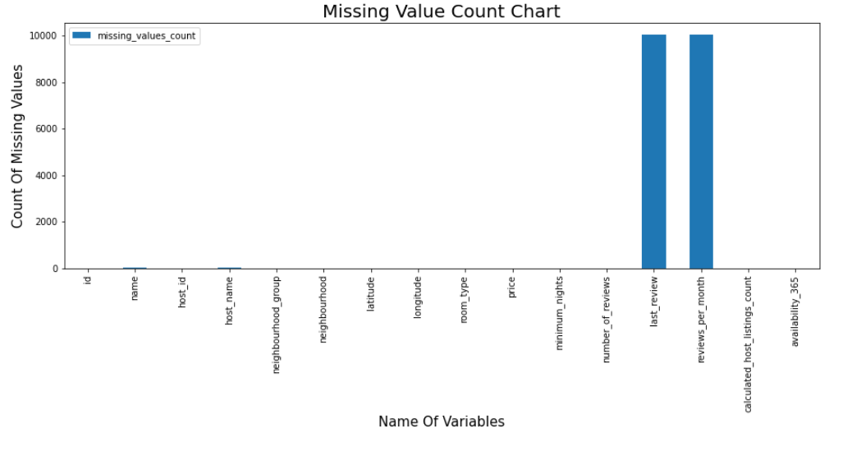
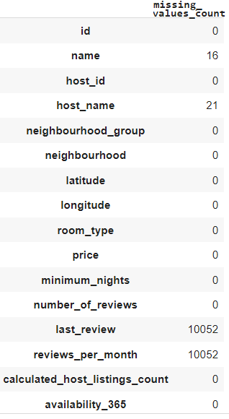
Missing Value Count Chart

Slide 8
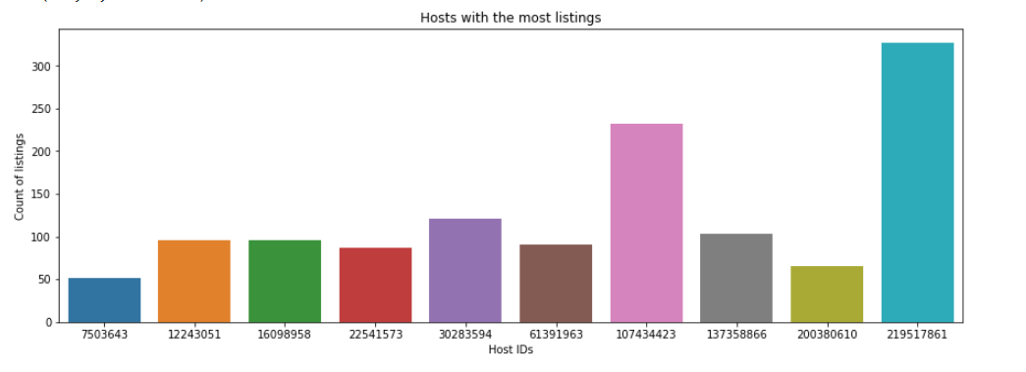
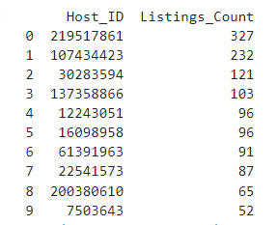
Top 10 Host Listing count chart

Slide 9
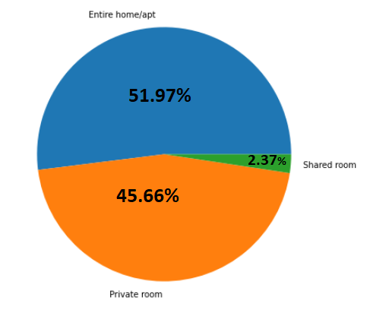
Room Type count chart
Entire home/apt: 25407
Private room: 22319
Shared room: 1158}

Slide 10
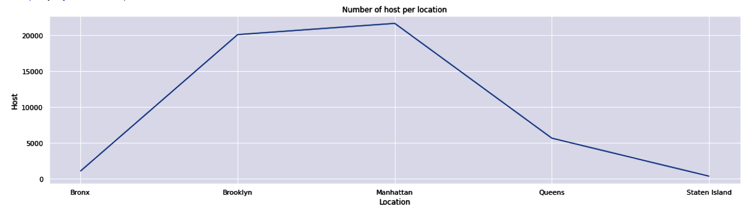
Active Host count per location chart
neighbourhood_group Bronx 1090
Brooklyn 20095 Manhattan 21660 Queens 5666
Staten Island 373

Slide 11
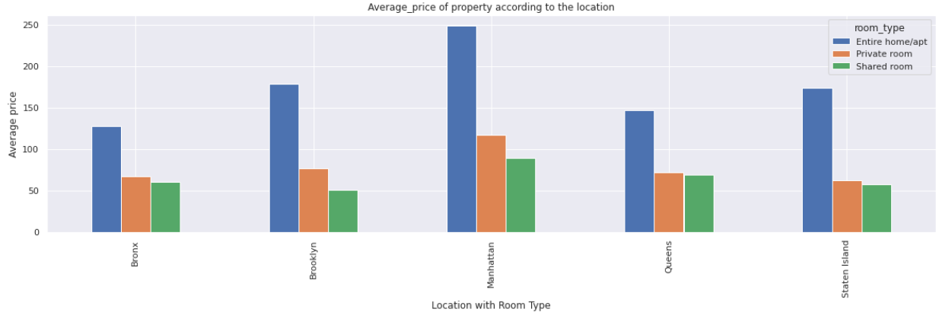
Average price of property
according to Location

Slide 12
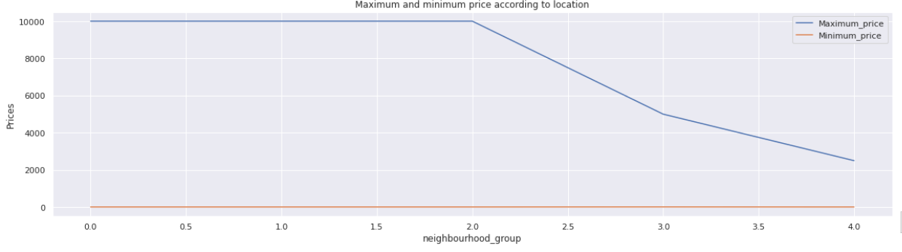
Highest and Lowest rent for location
neighbourhood_group Bronx 1090
Brooklyn 20095 Manhattan 21660 Queens 5666
Staten Island 373
Neighbourhood_group Maximum_price Minimum_price
0 Brooklyn 10000 10
1 Manhattan 10000 10
2 Queens 10000 10
3 Staten Island 5000 13
4 Bronx 2500 10

Slide 13
How analysis helpful for stakeholders in airbnb
Analysis can be incredibly helpful for stakeholders in Airbnb because it can provide valuable insights into the performance of the business, the behaviour of guests and hosts, and the preferences and trends in the market. Here are a few examples:
Market Trends: Analysis can help stakeholders stay up-to-date on market trends, such as which locations are most popular, which amenities are most in demand, and what types of properties are performing well. This information can be used to make strategic decisions about where to invest in new properties and how to market existing listings.

Slide 14
Host Performance: Analysis can help hosts evaluate their own performance by providing insights into how their listings compare to others in the area, how many bookings they receive, and how much they earn. This can help hosts identify areas for improvement and optimize their listings to increase revenue.
Guest Behaviour: Analysis can help stakeholders understand the behaviour of guests, such as their booking patterns, length of stay, and average spending. This information can help hosts optimize their listings to attract more guests and maximize revenue.

Slide 15
Conclusion
1. host_id reveals that some host have a huge number of property ownership above 300.
2. The Majority of the listings are located in Manhattan and Brooklyn whereas Bronx and Staten Island have a minimum number of shares.
3. Manhattan is the most expensive neighbourhood_group followed by Brooklyn Staten Island Queens and Bronx.
4.'Entire home/apt' room type has the highest number of listing of 51.97% and ‘Shared Room’ is the least listed room type at only 2.37% in total.

Slide 16
5. Brooklyn offers nearly the same number of private rooms and entire home whereas Manhattan offers highest number of entire homes followed by private rooms.
6. Listing of shared room is very little and staten islands and bronx offer very few shared rooms.
7. Brooklyn and Manhattan has the majority share of listings.

Slide 17
Thank you

